Slide 1


TY Coding
Lesson 06 - Conditional Statements

Slide 2
Equality Operators
We will be using equality operators to ask questions in our programs.
If something is true, do this, else if something is false then do this instead.
So, let's have a look at the equality operators we should know.
Operator | Meaning | Example | In words
> | Greater than | 8 > 6 | 8 is greater than 6
< | Less than | 4 < 9 | 4 is less than 9
== | Equal to | 10 == 10 | 10 is equal to 10
<= | Less than or equal to | 3 <= 4 | 3 is less than or equal to 4
>= | Greater than or equal to | 7 >= 7 | 7 is greater than or equal to 7
!= | Not equal to | 11 != 4 | 11 is not equal to 4

Slide 3
The IF Statement

Slide 4

The If Statement
We have learned how to take in data from the user and how to perform mathematical and string operations.
These skills are important in programming but now it is time to take the next step!
We are going to ask our programs questions and depending on the answers, our programs will perform a certain task.

Slide 5

Let's build a program that determines whether a person can drive based on their age.
So, what inputs will our program need?
Inputs: age
In Ireland people need to be 17 years old to drive, so based on this and the data taken in from the user, our program will tell people if they can drive or not.

Slide 6

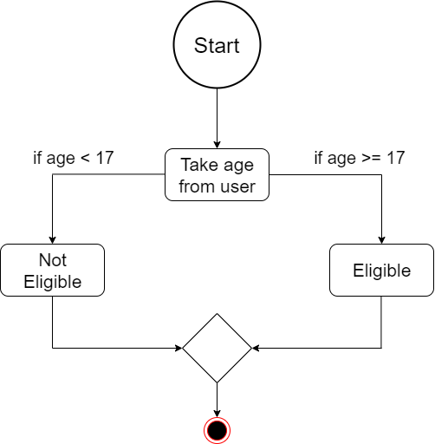
Algorithm
An algorithm is a set of steps to be followed to solve a problem.
This is what the algorithm for our program would look like

Slide 7
The IF statement
So what does this look like in our code?
age = int(input("Please enter your age? "))
if age >= 17:
print("You are eligible to apply for a driver's licence.")
if age < 17:
print("Sorry you cannot drive yet.")

Slide 8
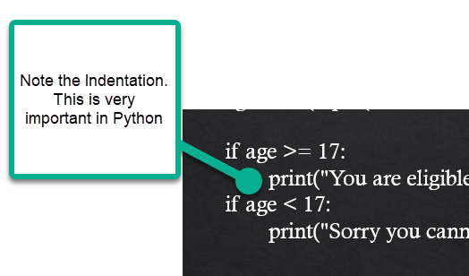
The Indentation tells python that this block of Code belongs to the statement above it.
Indentation is key to how python works with statements

Slide 9

What is happening?
The program will run as normal until it comes to the if statement.
It will evaluate if the statement is true or false.
If the statement is true, the program will execute the indented code block
if age >= 17: (Conditional If Statement)
print("You are eligible to apply for a driver's licence.") (Code that runs if statement is true)
The indented code block will execute only if the conditional if statement evaluates to true. If the if statement evaluates to false, the code block will be ignored.

Slide 10
If else (ELIF)

Slide 11

The ELIF statement
The if else elif statement is similar to the if else statement, but it adds in more conditions.
If the if statement evaluates to true, the if code block will be executed.
If one of the elif statements evaluates to true, the code block inside that elif will be executed.
If the if statement and all of the elif statements evaluate to false, the else code block will be executed.

Slide 12
age = int(input(“Please enter your age"))
if age > 17:
print(“You are eligible to apply for a drivers licence.“)
elif age == 17:
print(“You are exactly the right age.”) else:
print("Sorry, you cannot drive yet.")
User input variable
IF statement
First indented code block
ELIF statement
Second indented code block
ELSE statement
Third indented code block

Slide 13
By indenting a line, it becomes a block. A block is one is one or more consecutive lines indented by the same amount.
The indent is equal to 4 spaces or 1 tab. Coders around the world have arguments about whether to use tabs or spaces all the time, the fact is that it doesn’t matter.
Blocks can be used, as we saw here today, as part of an if statement. They’re the statement or group of statements that gets executed if the condition is true.
You can have as many elif statements as you require. In our example we only used one, but you can have 2, 3, 4 or more if you need.
In an if else, elif statement, as soon as one statement is found to be true, it will execute and no other code block will be executed in that if else elif statement.

Slide 14
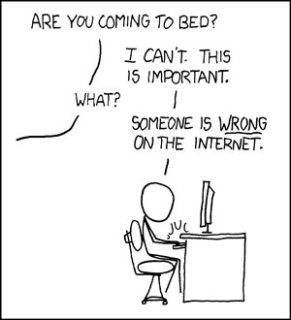

Slide 15
Summary
Today you learned about:
Equality operators: used to make comparisons between values.
< > == <= >= !=
We use == to check if one value is equal to another value.
Remember we use = to assign values to variables.
The if statement
If the if statement evaluates to true, the indented code block will execute.
If the if statement evaluates to false, the indented code block will be ignored.
Today you learned about:
The if else statement
Guarantees that either the if or the else code block will be executed
The if else elif
Like the else if statement but adds in more conditions.
In an if else elif statement, as soon as one statement is found to be true, it will execute, and no other code block will be executed in that if else elif statement.

